Slide 1
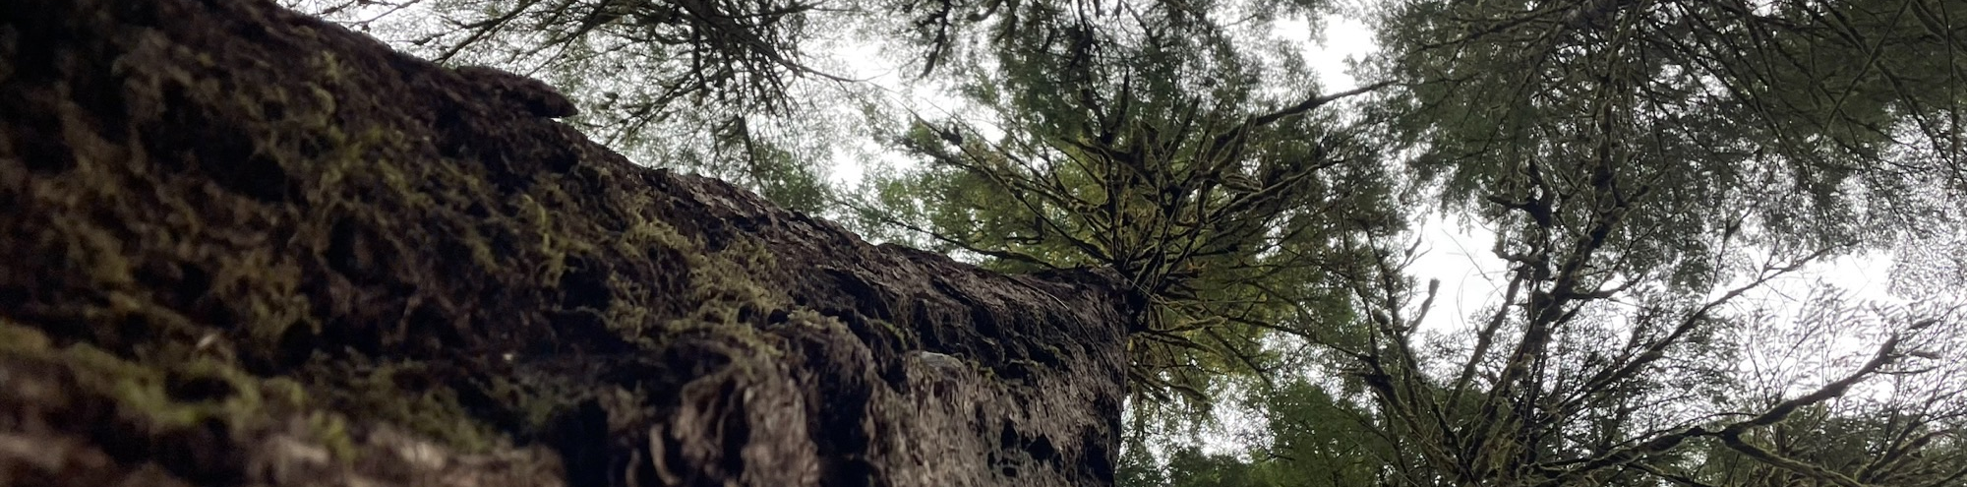
Contextualizing the 2021 Heat Dome Via Climatic Relationships, Dendrometry, and Dendrochronology
Flash Talk by Gabby John for the December 2024 HJ Andrews Monthly Meeting

Slide 2
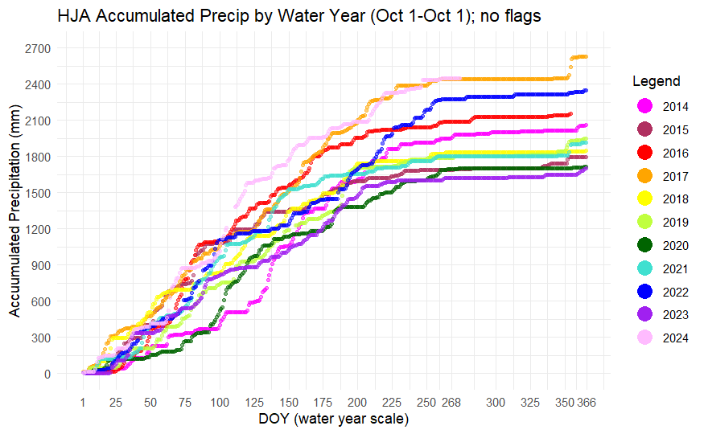
Problems? Solutions?
Patterns of tree growth
how does recent climate change affect this?
2021 Heat Dome
unprecedented & significant
Heat waves & drought
complex & challenging to disentangle

Slide 3
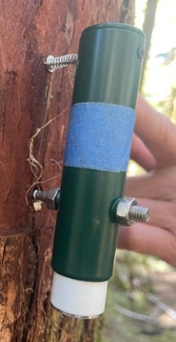
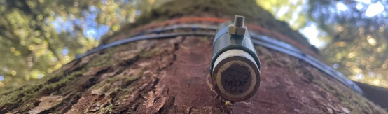
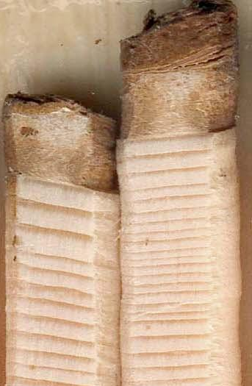
How do we achieve this?
Multi-faceted analysis of…
High-resolution dendrometers (short-term changes)
Tree cores (long-term patterns)
Met station microclimate data (VPD, air temp, precip, etc.)

Slide 4
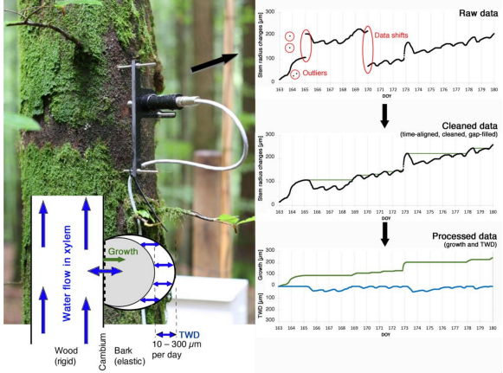
How does it work?
Knüsel, Peters, Haeni, Wilhelm, & Zweifel 2021
Stem size fluctuates
Task = identify what expansion is permanent

Slide 5
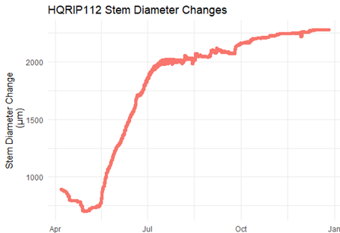
Unprocessed Data (~50y DF)
Raw output
Incremental changes in diameter
Douglas-fir near HJA headquarters
Fall rain bumps

Slide 6
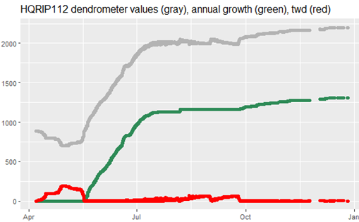
TreeNetProc Processed Data
Gray line: raw dendro output
Green line: processed output
Red line: estimate of tree water deficit
Thick circle: spring shrinkage
Thin circle: “smoothed” growth reducing “bumps” in output

Slide 7
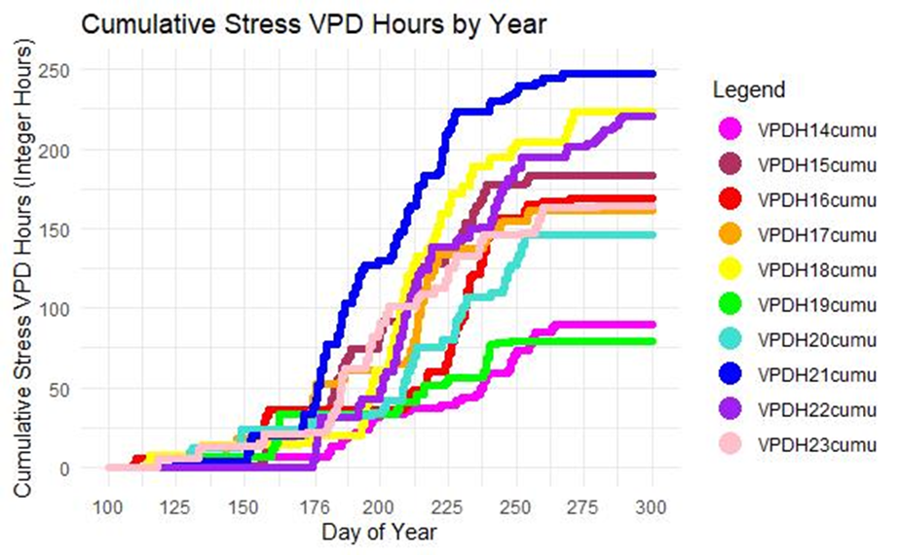
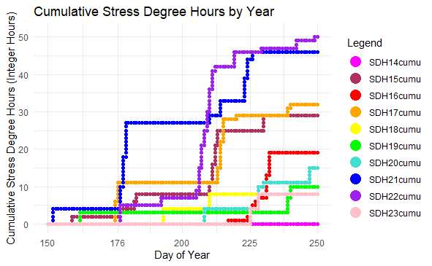
Microclimate
Tentative thresholds
≥35° C ; ≥3 kPa
Onset of Heat Dome
Onset of Heat Dome
Supports Heat Dome intensity
Ready to compare with tree data
Source: Discovery Tree met station

Slide 8
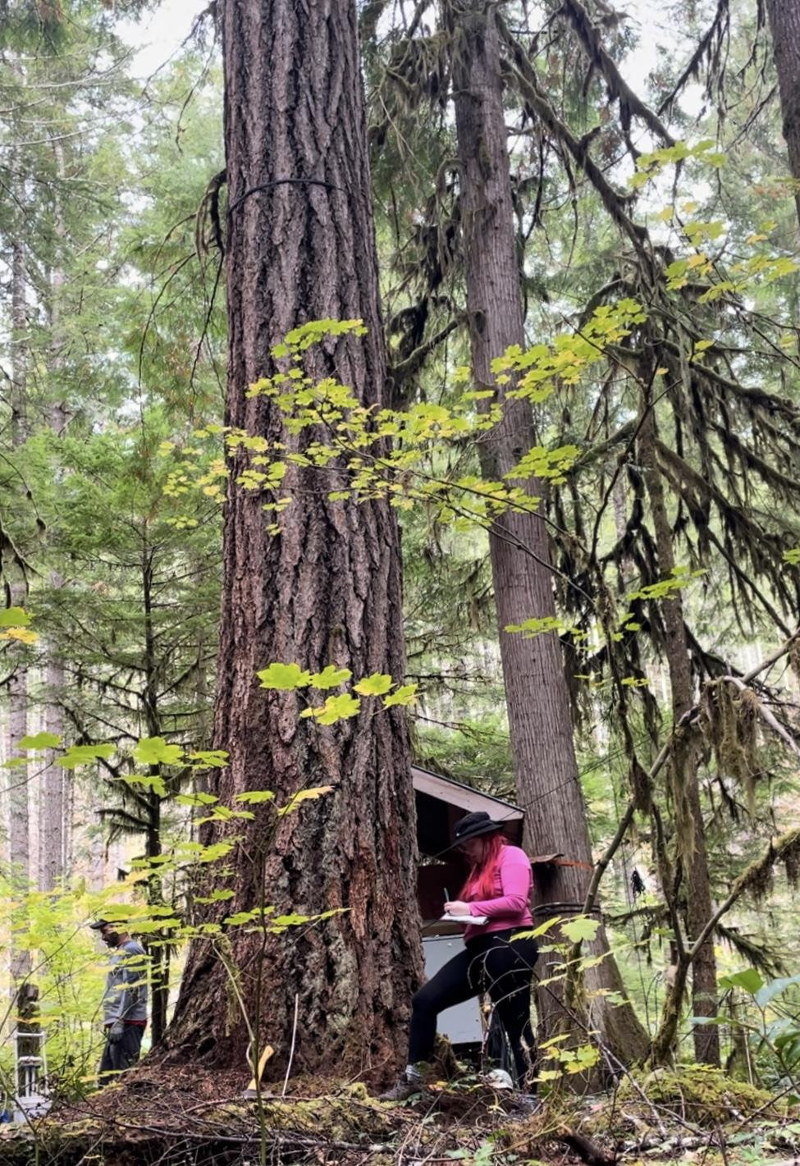
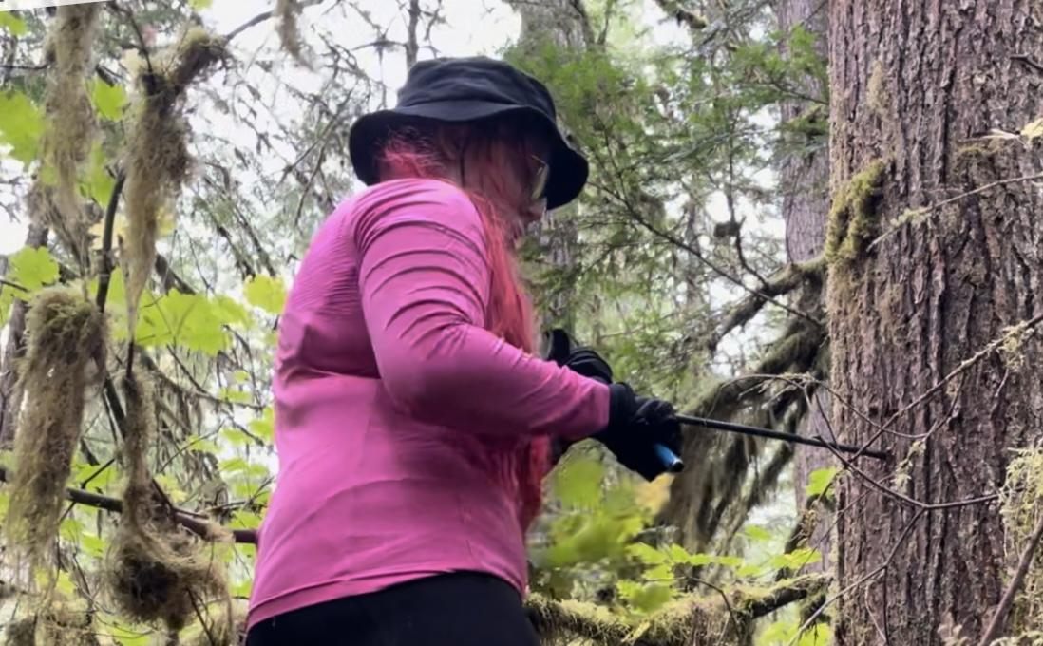
THANK YOU! :-)
Please reach out!
johnga@oregonstate.edu

